Slide 1
WEL-COME

Slide 2



Accredited by NACC B++ & An ISO 9001:2015 certified Institute
SANT GAJANAN MAHARAJ COLLEGE OF ENGINEERING
MAHAGAON
Department of Computer Science & Engineering
Academic Year 2020-21

Slide 3


Slide 4

Name Of Project - CodeHustle Group members:- 1.Chilami Bobby Devappa 2.Shinde Dhanashree Ajitkumar 3.Kokare Janhavi Vivek 4.Rokade Jyoti Chandrakant Guide name:- Mr .C. H. Kamble

Slide 5
INDEX
Abstract
Introduction
Existing system
System Architecture
Users
Advantages
References

Slide 6
ABSTRACT
Nowadays, everything is computer-aided from our alarm clock to coffee machine to automated cars and even our Houselights (Hi Alexa!, OK Google), none of these would have been possible without Computers, and the language that runs them is Coding.
Since coding much important to learn, some students come across the hype surrounding coding very late as they don’t have available resources.
The aim of this project is to collect all the resources on a single platform, and make it available to everyone.
This project provides all the basic and moderate knowledge about many languages, Frameworks, Databases and Data Structures and Algorithms.
CodeHustle is a web application that provides a vast range of Coding round questions for practicing, where students can sign up, practice and discuss with their peers.

Slide 7
INTRODUCTION
The technological development trend in software engineering has been improving, where the design of software began to move from the desktop to the web.
Students learn to take advantage of the unique resources available for those enrolled in internet-based programs and to make the most of their Web-based educational experience by tailoring it to their personal strengths, needs, and learning styles.
Thus, the objective of the project is to build a web-based solution which will help programmers to learn and interact with fellow programmers, this platform will provide all the important preparation resources which are required for succeeding in an interview.

Slide 8
EXISTING SYSTEM
Existing System consists of only the theoretical resources which are not organized well and the students get confused over which platform is best for learning.
The proposed system will have the feature for clearing any doubts through discussion.
The major issue in today’s incompetence of coding rounds among students is not enough practice of medium to hard level programming questions. But it can be solved by peer-programming and CodeHustle is specially designed with a large variety of programming questions, where the complexity is in ascending and the students will be able to gradually hone their logical and algorithmic skills.
The second issue is aptitude preparation, in the existing system students surf through internet for aptitude questions where they just read the questions and see the answer, this is not a good learning method as they don’t solve the questions themselves and thus they are unaware of their own capability. CodeHustle have a quiz section where the mentors can create aptitude tests and students can solve them as they please. This feature will allow to monitor their results and the progression as well.

Slide 9
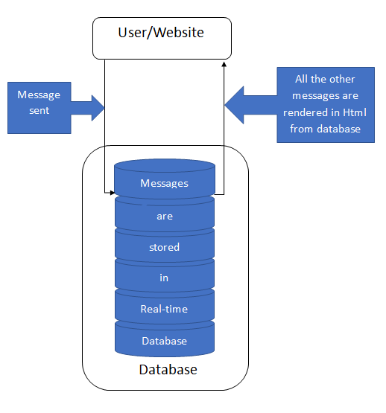
System Architecture: Discussion session

Slide 10
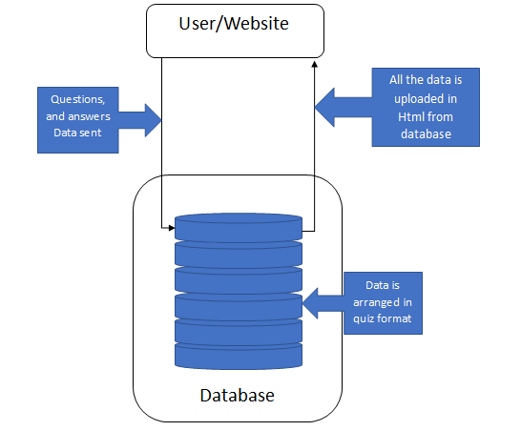
Quiz Section

Slide 11
USERS
Enthusiastic students who are willing to be prepared for technical interviews.
Students/any person who want to do peer-programming.
Lecturers who intend to assign a swift and simple quiz task for students.
Any person who wants to learn programming and development.

Slide 12
ADVANTAGES
1. Discuss and learn feature.
2. 400+ Handpicked Coding interview questions for practice.
3. Platform for creating and solving assignment quizzes for
aptitude preparation.
4. Overwhelming structured course resources of over 10+
languages and frameworks for development preparation

Slide 13
REFERENCES
Practical Remote Pair Programming by Adrian Bolboacǎ (Author)
https://firebase.google.com/docs/guides
3. https://www.freecodecamp.org/

Slide 14
THANK YOU

